Slide 1
Tutorial Week 5 Xlib programming
Liu Haolin
Email: 115010192@link.cuhk.edu.cn

Slide 2
Xlib
Xlib is a graphics library that is used to draw a picture on the screen.
In Xlib, it is required to draw the picture pixel by pixel.
One important feature of Xlib is X forwarding, which can display the picture on your own computer while you login to a remote machine.
Xlib manual: https://www.x.org/releases/X11R7.5/doc/libX11/libX11.html

Slide 3
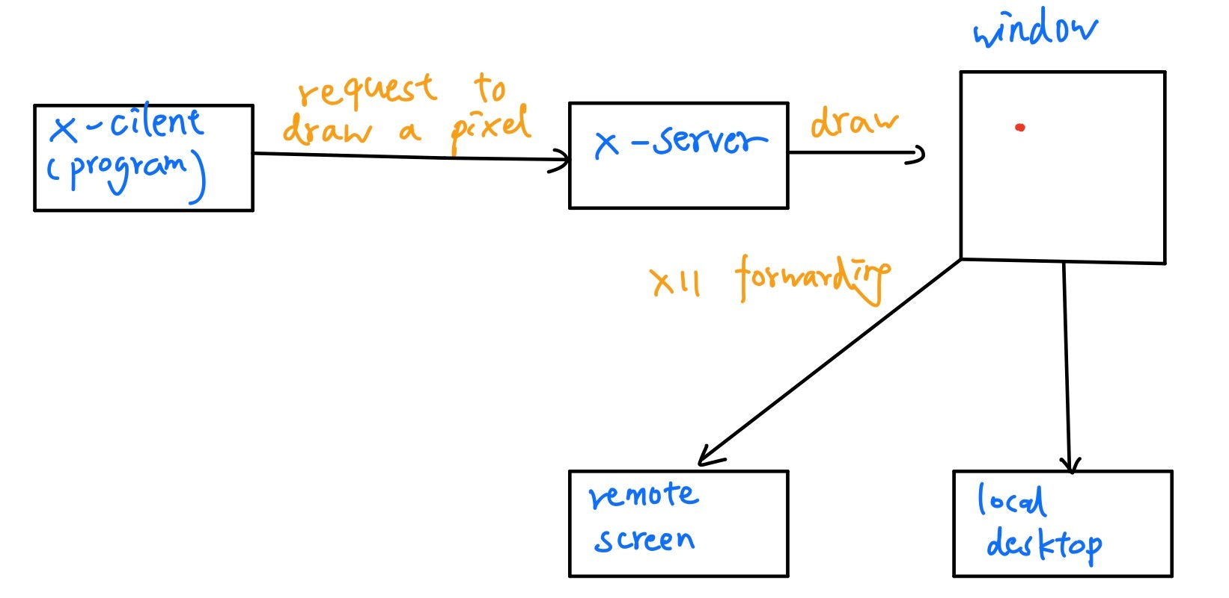
Xlib Architecture
Xlib is a server-client architecture. The X-client (program) send draw request to the X-server, the X-server would draw according to the request and send it back to the X-client. The communication is based on X protocol, built on TCP/IP.

Slide 4


Compile a Xlib program

Slide 5
Run Xlib program on remote server
Windows 10: use MobaXterm, default enable X11 forwarding.
Mac OS: download Xquartz. Firstly ssh –X username@10.26.1.12, then
ssh –X username@172.16.44.131

Slide 6
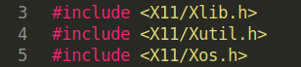
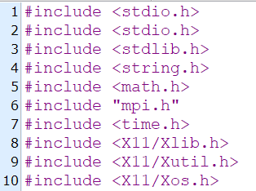
Included files
For MPI program, make sure include X11’s header files after the “mpi.h”

Slide 7
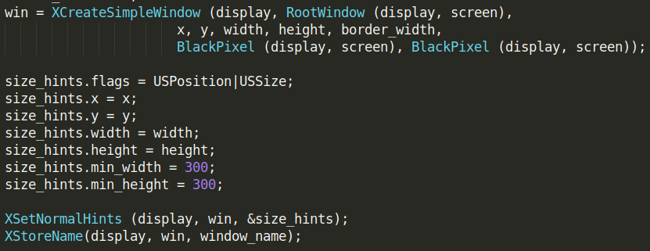
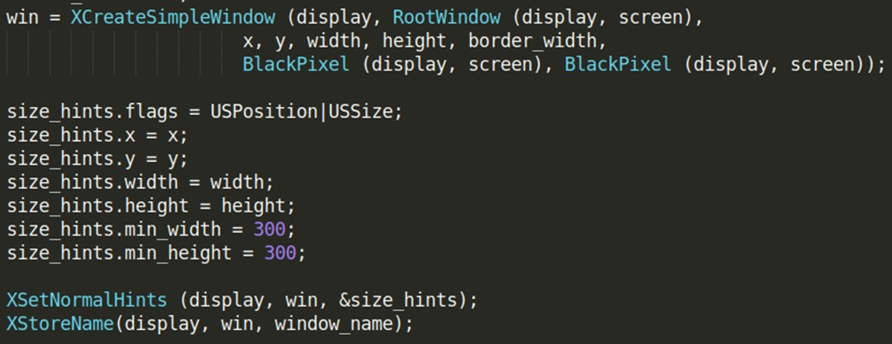
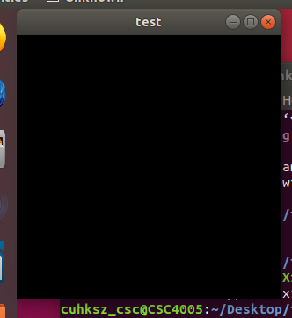
Initialization codes
You only need to copy from the example codes.
These several lines create a black window with certain width and height.

Slide 8
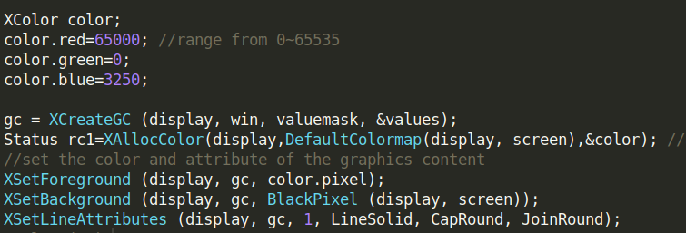
Graphics content
Graphics content is similar to a basic graphic unit, it can store a specific pixel color, which you can use to draw a point on the window.

Slide 9
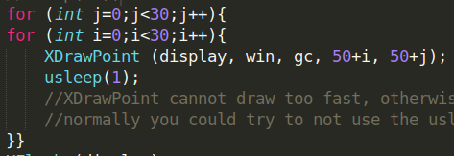
Request drawing
Send draw request to X server to, the pixels will not be drawn yet during inside the for loop. Usleep() is important, if sending request too frequently, the later request will destroy the former request.

Slide 10
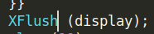
Request to execute the drawing
After the drawpoint request is sent, XFlush() will request the server to execute all the drawpoint request sent previously.

Slide 11
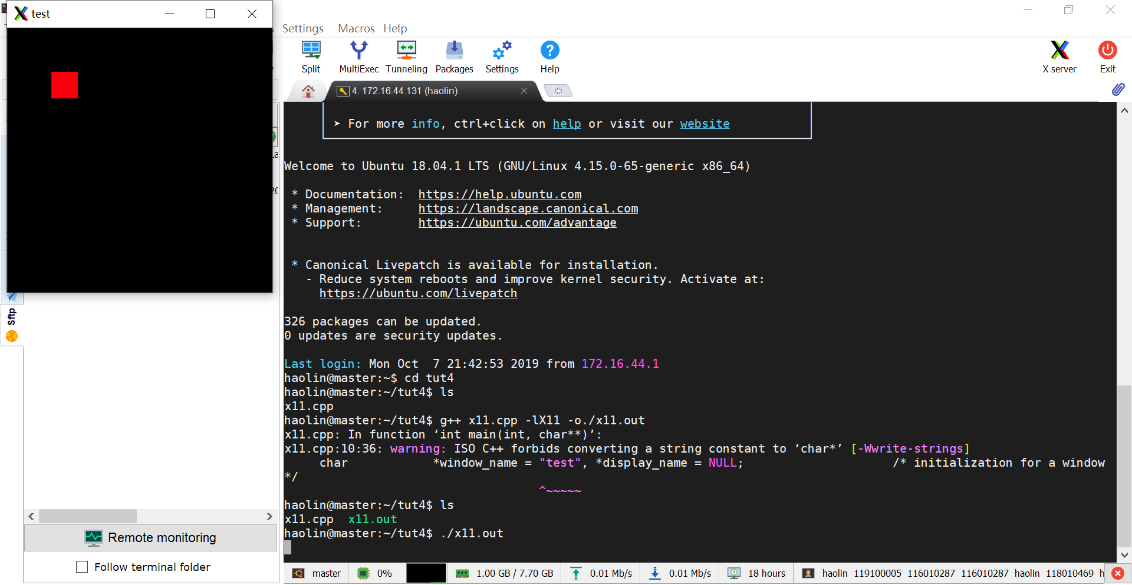
Output of x11.cpp

Slide 12
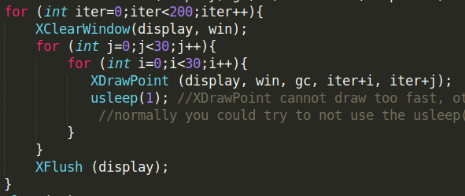
Continuously refresh the window
Draw a moving object. Use XClearWindow() to clear the previous frame, and draw the window frame by frame.

Slide 13
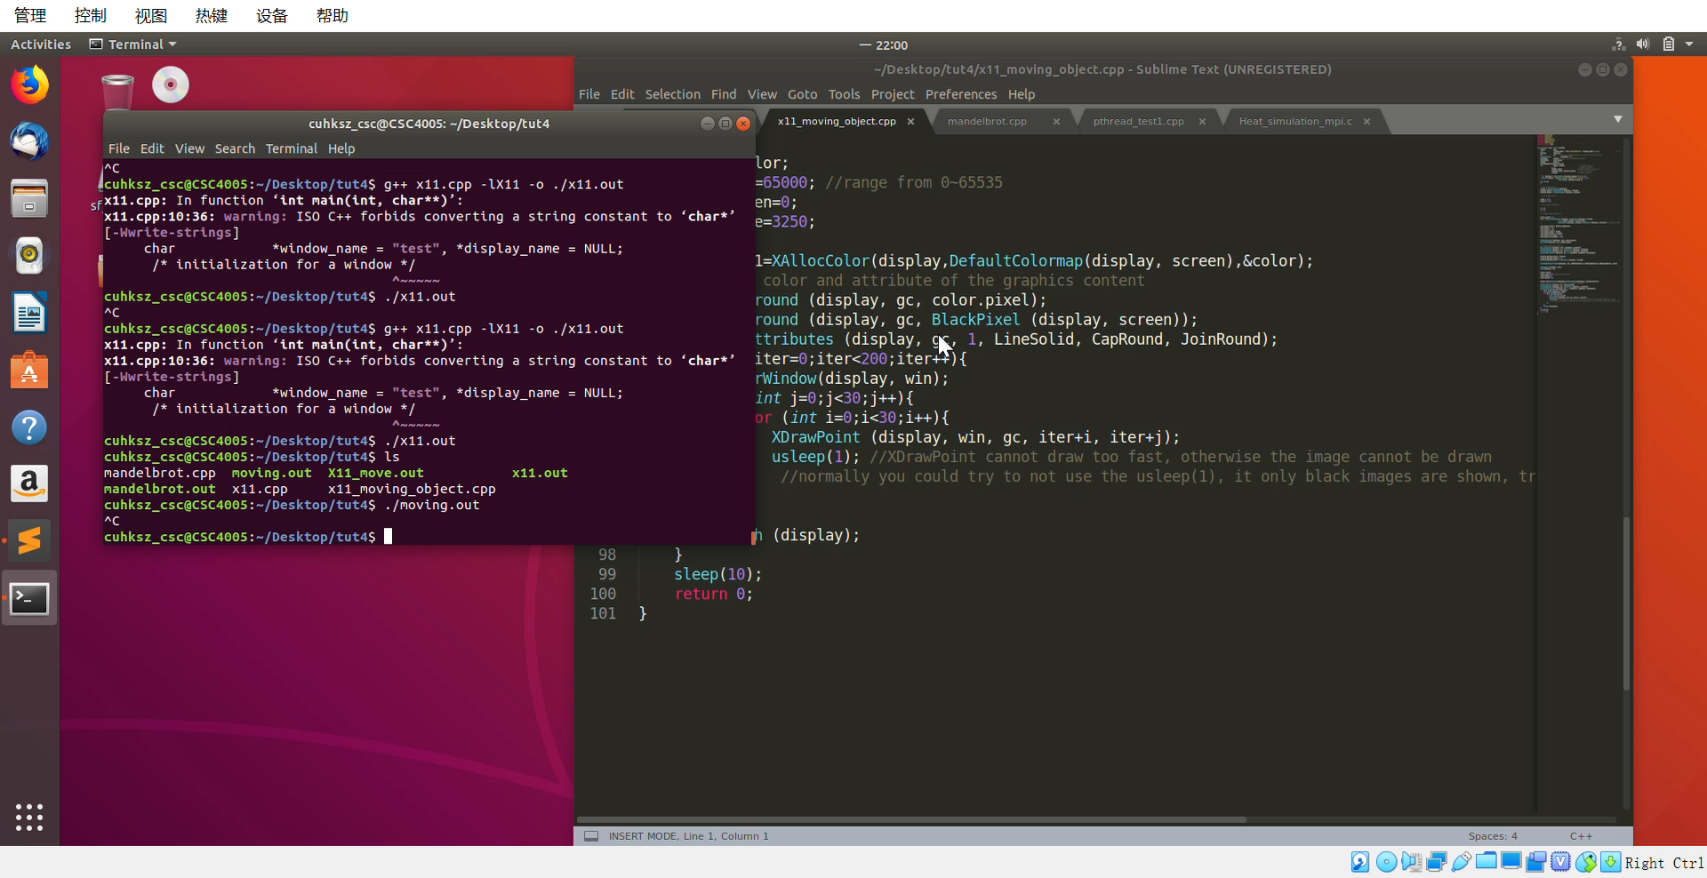
Result

Slide 14
Exercise
Draw a green moving object on a white screen.

